Slide 1
Parkinson's disease
► Parkinson's disease is a progressive disorder that affects the nervous system and the parts of the body controlled by the nerves. Symptoms start slowly. The first symptom may be a barely noticeable tremor in just one hand. Tremors are common, but the disorder also may cause stiffness or slowing of movement.
► In the early stages of Parkinson's disease, your face may show little or no expression. Your arms may not swing when you walk. Your speech may become soft or slurred. Parkinson's disease symptoms worsen as your condition progresses over time.
► Although Parkinson's disease can't be cured, medicines might significantly improve your symptoms. Occasionally, a health care professional may suggest surgery to regulate certain regions of your brain and improve your symptoms.

Slide 2
Dependencies Used :-
Numpy : - NumPy is a Python library used for working with arrays. It also has functions for working in domain of linear algebra, fourier transform, and matrices. NumPy was created in 2005 by Travis Oliphant. It is an open source project and you can use it freely.
Pandas : - Pandas is a Python library used for working with data sets. It has functions for analyzing, cleaning, exploring, and manipulating data. The name "Pandas" has a reference to both "Panel Data", and "Python Data Analysis" and was created by Wes McKinney in 2008.
Scikit-learn : - Scikit-learn is probably the most useful library for machine learning in Python. The sklearn library contains a lot of efficient tools for machine learning and statistical modeling including classification, regression, clustering and dimensionality reduction.

Slide 3
Tools :-
Sklearn.model_selection.train_test_split() function : -
The train_test_split() method is used to split our data into train and test sets. First, we need to divide our data into features (X) and labels (y). The dataframe gets divided into X_train, X_test, y_train, and y_test. X_train and y_train sets are used for training and fitting the model. The X_test and y_test sets are used for testing the model if it’s predicting the right outputs/labels. we can explicitly test the size of the train and test sets. It is suggested to keep our train sets larger than the test sets.
Sklearn.preprocessing : - The sklearn.preprocessing package provides several common utility functions and transformer classes to change raw feature vectors into a representation that is more suitable for the downstream estimators.

Slide 4
Python sklearn StandardScaler() function
Python sklearn library offers us with StandardScaler() function to standardize the data values into a standard format.
Before getting into Standardization, let us first understand the concept of Scaling.
- Scaling of Features is an essential step in modeling the algorithms with the datasets. The data that is usually used for the purpose of modeling is derived through various means such as:
Questionnaire
Surveys
Research etc.

Slide 5
- So, the data obtained contains features of various dimensions and scales altogether. Different scales of the data features affect the modeling of a dataset adversely.
It leads to a biased outcome of predictions in terms of misclassification error and accuracy rates. Thus, it is necessary to Scale the data prior to modeling.
This is when standardization comes into picture.
Standardization is a scaling technique wherein it makes the data scale-free by converting the statistical distribution of the data into the below format:
mean - 0 (zero)
standard deviation – 1
By this, the entire data set scales with a zero mean and unit variance, altogether.

Slide 6
Support Vector Machine:-
A support vector machine (SVM) is a type of supervised learning algorithm used in machine learning to solve classification and regression tasks; SVMs are particularly good at solving binary classification problems, which require classifying the elements of a data set into two groups.
The aim of a support vector machine algorithm is to find the best possible line, or decision boundary, that separates the data points of different data classes. This boundary is called a hyperplane when working in high-dimensional feature spaces. The idea is to maximize the margin, which is the distance between the hyperplane and the closest data points of each category, thus making it easy to distinguish data classes.
SVMs are useful for analyzing complex data that can't be separated by a simple straight line. Called nonlinear SMVs, they do this by using a mathematical trick that transforms data into higher-dimensional space, where it is easier to find a boundary.

Slide 7
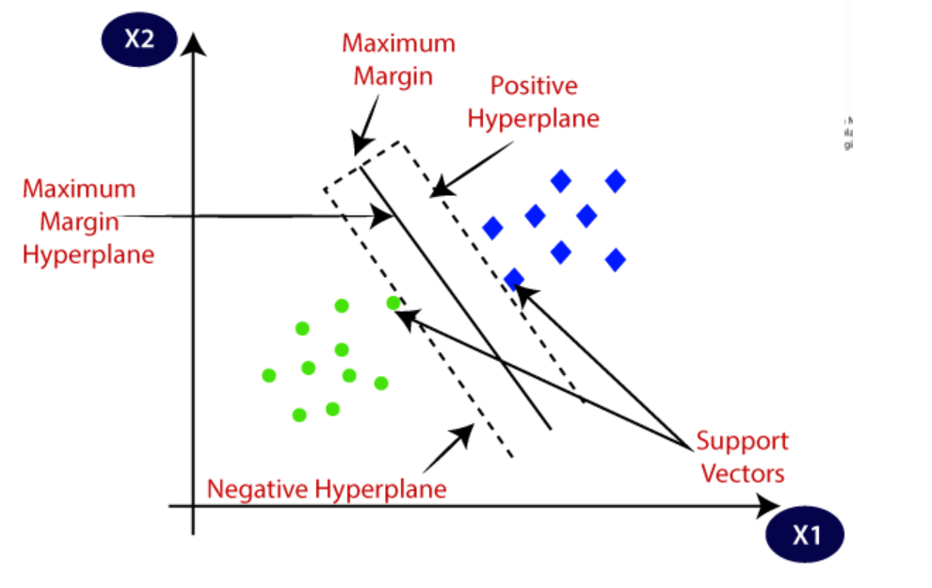

Slide 8
sklearn.metrics.accuracy_score :-
What is Accuracy?
One of the widely used metrics that computes the performance of classification models is accuracy. The percentage of labels that our model successfully predicted is represented by accuracy. For instance, if our model accurately classified 80 of 100 labels, its accuracy would be 0.80.
Accuracy using Sklearn's accuracy_score() :-
The accuracy_score() method of sklearn.metrics, accept the true labels of the sample and the labels predicted by the model as its parameters and computes the accuracy score as a float value, which can likewise be used to obtain the accuracy score in Python. There are several helpful functions to compute typical evaluation metrics in the sklearn.metrics class. Let's use sklearn's accuracy_score() function to compute the Support Vector Classification model's accuracy score using the same sample dataset as earlier.

Slide 9
Thank You…
Project by:-
1.) Abhijeet Pratap Singh (2101221640004)
2.) Aditya singh (2101221640008)
3.) prerak Tiwari (2101221640040)
4.) Yash Pratap singh (2101221640060)

